Slide 1
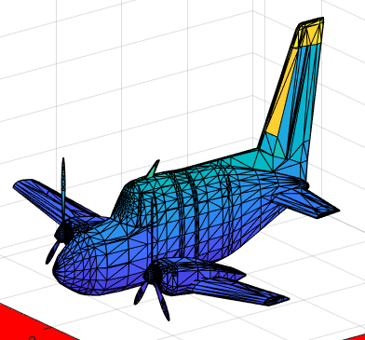
Point Cloud Data to STL
Presentation by:
Durganshu Mishra (2016086)

Slide 2
Objective
To generate a .stl file using point cloud data imported from a CAD model/.ply file

Slide 3
Import the point cloud data from a .txt file
Import the .txt file containing triangulation information
Compute facet normal using the information received from the files
Write the data in a .stl file
Create a GUI
Work Flow
Take inputs from the user
Import the functions created in first 4 steps
Create the file and show the .stl in the gui itself

Slide 4
Functionalities achieved
Can generate any kinds of intricate surfaces and volumes
Easy to use Graphical User Interface
Generate .stl file as an ASCII encoded file
Upload files from any folder in the PC.
Plotting of .stl file in the GUI window (for better visualisation)

Slide 5
Scope of Improvement
PLY to STL converter can be created using the functionalities of the project
More complex file formats can be used for importing data.
Make a more generic programme to create .stl file in any of the ASCII or Binary encoded file

Slide 6
References:
“DIFFERENT ALGORITHMS FOR GENERATION OF STL FILE FOR MEASURED POINT CLOUD DATA” by Dr. Arati Mulay and Dr. B.B.Ahuja
A Methodology to create STL Files from Data Point Clouds Generated with a Coordinate Measuring Machine by Irenee Tyvaert, Universitede Technologie de Troyes, France

